Slide 1
Web services
Java web services

Slide 2
About Distributed Technologies
Let’s discuss about distributed technologies, before deep drive in to web services.
Distributed Application is an application that can be distributed. Simply Distributed applications interact each other.

Slide 3
Distributed Technologies which are provided by Java (SUN)
1. RMI
2. EJB

Slide 4
RMI
RMI stands for Remote Method invocation. Which is given by SUN microsystem. It’s a java technology to develop Distributed application.
We have some drawbacks with RMI.
RMI gives language dependent service, that means only java applications can interact each other.
AS a developer, We have to take care about business logic and Middle ware services to expose application as a service .
Developing middle ware services is a extra task to the developer.
To overcome this issue, EJB was introduced by SUN.

Slide 5
EJB
EJB stands for Enterprise java Bean. It’s mainly used for developing distributed applications.
We have drawback with EJB also.
EJB also gives a language dependent service. So only java application can provide service and can consume service.
To overcome this drawback, Webservices were introduced by WS – I (Web Service – Interoperability )

Slide 6
Webservices overview
Webservices were introduced by WS-I.
WS-I – Web Service Interoperability is a open source community provided some specifications in the form of Basic Profile documentations to achieve language independent service (interoperability).
Following are the specifications.
B.P – 1.0
B.P – 1.1
B.P – 1.2
B.P – 2.0

Slide 7
Different technologies provided APIs to the specifications.
As you know, specification contains only information.
Java provided APIs for Webservices as follows
1. JAX- RPC
2. JAX – WS
3. JAX – RS
JAX RPC, JAX- WS are used for developing SOAP Webservices.
JAXRS is used for developing RESTFUL Webservices.
Note: JAVX – RPC 2.0 was renamed to JAX-WS

Slide 8
Implementations for Web services
JAX-WS API implementations
AXIS-2
Apache CXF
JAX-RS API implementations
Jersey,
RESTEasy,
Apache CXF, and
Spring with REST

Slide 9
What is SOA??
Service Oriented Architecture or SOA is a design pattern. It is designed to provide services to other applications through protocol. It is a concept only and not tied to any programming language or platform.
Webservice is the implementation of SOA concept.

Slide 10
1. Introduction to Web services

Slide 11
What is Web Service?
A Service, which is available on web (net)
Web services is a Distributed technology achieves language interoperability (portability) across different technologies such as java, .net, PHP, C++, etc.
The other distributed technologies like CORBA, RMI, EJB, DCOM, C++, etc uses Binary Format, hence the objects are serialized into stream of bytes.
Web services uses XML format instead of Binary format. Hence, in Webservices data is exchanged as XML message, which is validated against XML Schema (XSD) but not DTD, since XSD additionally supports datatypes.
The Webservices technologies such as SOAP, WSDL, UDDI are represented in XML against corresponding schemas.
Webservices makes distributed applications development easier.

Slide 12
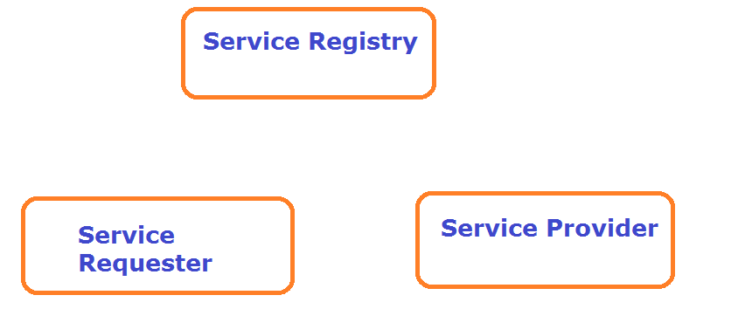

Slide 13
Service Provider
The service provider is a developer, who creates web services.
Service Provider creates web service. Typically the service provider exposes certain business functionality in their organization as a web service.
The service provider describes service in technology neutral format (such as wsdl format and publish in central repository for wider audience.
Service Registry
A service Registry is a central location where the service provider can list its web services, and where a services consumer can search for web services.
The web service is a central registry is publicly available to everyone.
Service Requester
Discover service details from central registry and invokes service.

Slide 14
Webservices
Web service is a way of communication that allows interoperability between different applications on different platforms, for example, a java based application on Windows can communicate with a .Net based one on Linux. The communication can be done through a set of XML messages over HTTP protocol.
Web Services take Web-applications to the Next Level.

Slide 15
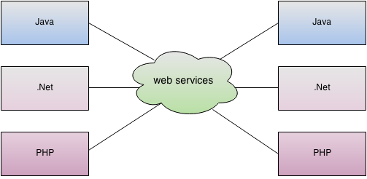
Webservice achieves language independent

Slide 16
What are different types of web services?
SOAP
RESTFUL Web Services

Slide 17
Types of Web services
Webservice
SOAP
JAX-WS
RESTFUL
JAX-Rs

Slide 18
Notes
SOAP web services are old
RESTFUL web services are new
JAX-WS and JAX-RS are specifications

Slide 19
What they are and how they are useful?
Two different applications in two different servers connect with each other using web services over the network.
Java piece of code can access .Net code

Slide 20
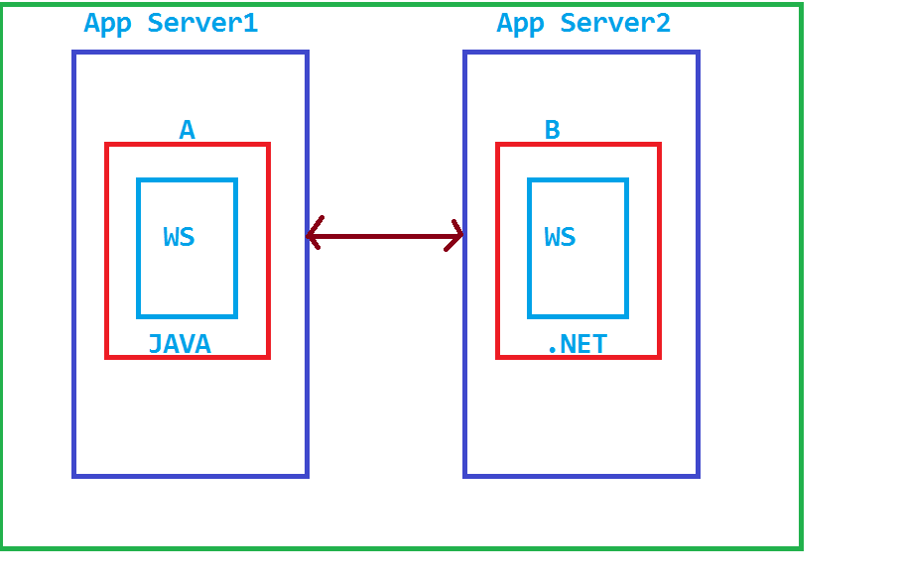
Web services

Slide 21
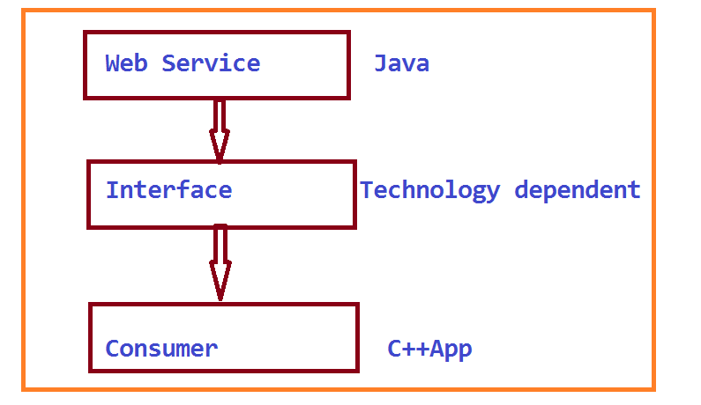
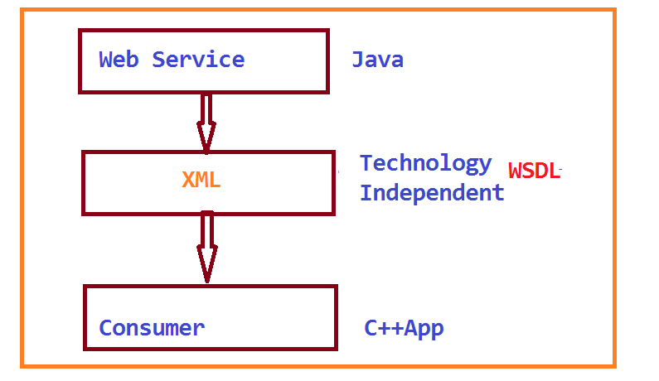
Technology Independent and Technology Dependent

Slide 22
What are features of web services?
Reuse already developed(old) functionality into new software:
Interoperability :
Loosely Coupled: Individual pieces of the application to be modified without impacting unrelated areas.
Ease of Integration:
Deployable

Slide 23
Let’s discuss SOAP web services first
What is Simple Object Access Protocol(SOAP):
SOAP is a protocol specification for exchanging structured information in the implementation of Web services in computer networks. It relies on XML as its message format.
A simple web service architecture have two components Client
Service Provider

Slide 24
Advantages of Soap Web Services
WS Security: SOAP defines its own security known as WS Security.
Language and Platform independent: SOAP web services can be written in any programming language and executed in any platform.
Disadvantages of Soap Web Services
Slow: SOAP uses XML format that must be parsed to be read. It defines many standards that must be followed while developing the SOAP applications. So it is slow and consumes more bandwidth and resource.
WSDL dependent: SOAP uses WSDL and doesn't have any other mechanism to discover the service.

Slide 25
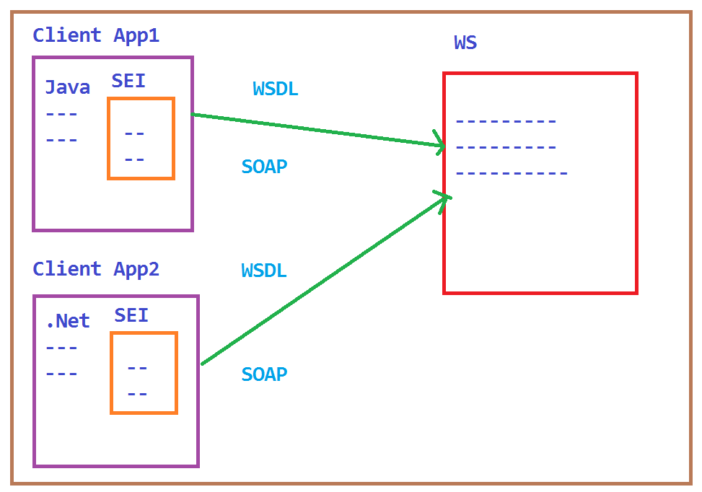
SOAP Web service

Slide 26
SOAP web service flow
object--serialized to-->XML message --added to--> <soap:Body> --becomes payload of-->HTTP Request message

Slide 27
Some jargons used in SOAP Web services:
WSDL
UDDI

Slide 28
Web Service Description Language(WSDL):
WSDL stands for Web Service Description Language. It is an XML file that describes the technical details a web service.
WSDL file more specifically contains the URI, port, method names, arguments, and data types.
Since WSDL is XML, it is both human and machine readable, which aids in the ability to call and bind to services dynamically.
WSDL is mainly for SOAP web services.
WSDL is a contract between service provider and consumer and can be used by various roles in various ways.
Various roles:
1. Analyst: will explain to the client about web serivce
2. Developer
3. Tester – Uses SOAP UI to test web service
4. Client/Consumer

Slide 29
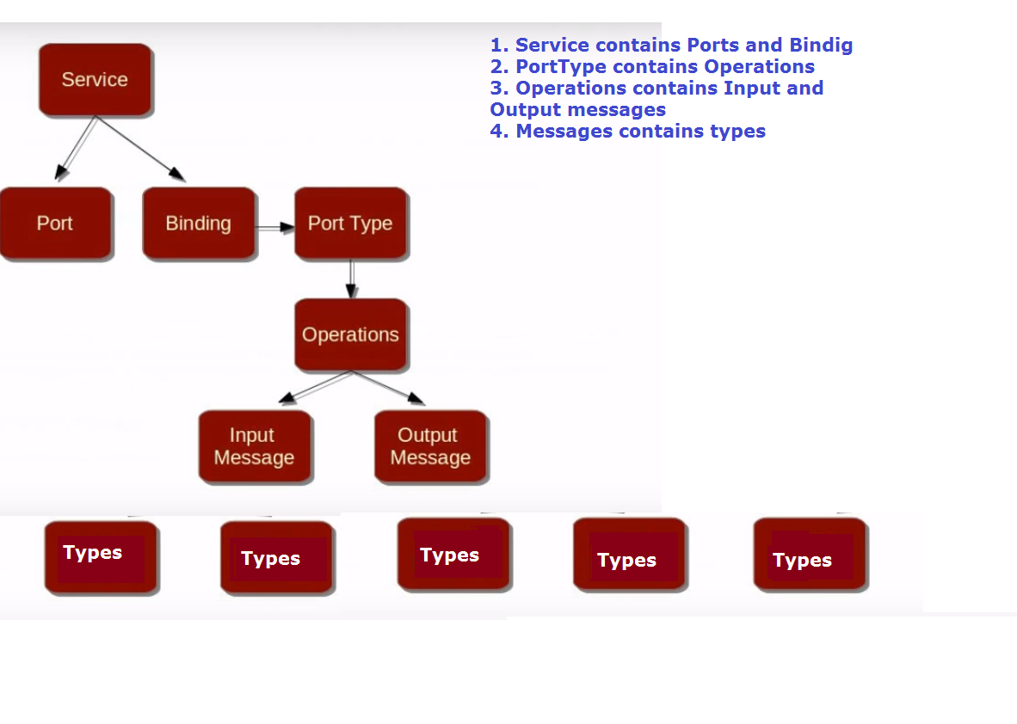
WSDL simplification Diagram Always understand the WSDL file from service tag.

Slide 30
Wsdl file is categorized in to two parts based on what and how??
WSDL file contains
Descriptions
Types What
Messages
Operations
Porttype
----------------------------------------------------------------------------------------------------
Binding
How
Service

Slide 31
Elements of WSDL are:
Description: It is the root element of a WSDL 2.0 file. It usually contains a set of name space declarations which are used throughout the WSDL file. Types: Request and response types can be defined The WSDL types element describes the data types used by your web service.Data types are usually specified by XML schema.It can be described in any language as long as your web services API supports it. Binding: The WSDL binding element describes how your web service is bound to a protocol. In other words, how your web service is accessible. To be accessible, the web service must be reachable using some network protocol. This is called "binding" the web service to the protocol. Interface: The WSDL interface element describes the operations supported by your web service.It is similar to methods in programming language.Client can only call one opertion per request. Service: It describes the endpoint of your web service. In other words, the address where the web service can be reached. Endpoint: The endpoint element describes the address of the web service. The endpoint binding attribute describes what binding element this endpoint uses.i.e. protocol with which you will access web service. The address attribute describes the URI at which you can access the service. Message: Input , Output, Fault messages can be defined The message element describes the data being exchanged between the Web service providers and consumers.
Operations: Methods

Slide 32
Note points
Here targetnamespace in wsdl file is like package in java. It is for differntiating types, messages, porttypes.

Slide 33
Simple WSDL file

Slide 34
UDDI
UDDI stands for Universal Description Discovery and Integration.
It’s a registry to register web services.

Slide 35
Ways to access web service:
There are two ways to access web service Read more at http://www.java2blog.com/2013/03/soap-web-service-tutorial.html#JOwllKRc2RIHpuew.99
If Service provider knows client
Service provider register its WSDL to UDDI and client can access it from UDDI Read more at http://www.java2blog.com/2013/03/soap-web-service-tutorial.html#JOwllKRc2RIHpuew.99

Slide 36
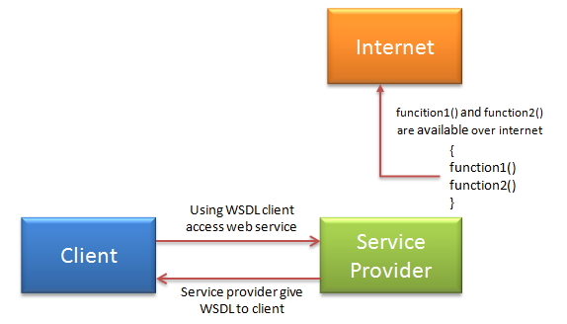
1. If Service provider knows client:If service provider knows its client then it will provide its wsdl to client and client will be able to access web service.

Slide 37
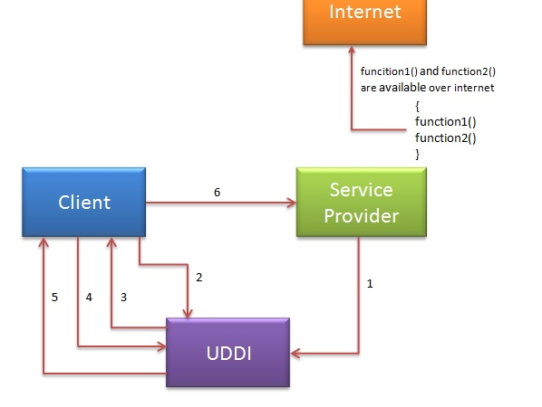
2. Service provider register its WSDL to UDDI and client can access it from UDDI
Web services can register with a UDDI and make themselves available through it for discovery.So following steps are involved.
Service provider registers with UDDI.
Client searches for service in UDDI.
UDDI returns all service providers offering that service.
Client chooses service provider
UDDI returns WSDL of chosen service provider.
Using WSDL of service provider,client accesses web service.

Slide 38
Web service design approaches:
Contract last or Bottom up approach:
When using contract last approach,you first write your java code then you create web service contract(WSDL) .There are various kinds of tools which can generate WSDL on the basis of java code.
Contract first or Top Down Approach :
It is reverse of contract first.Here you first define web service contract.You define all the elements of WSDL first then after that you create your java logic.

Slide 39
What is JAX-WS?
It is java API for XML web services. JAX-WS is standard XML based java API which is used to create SOAP web services.

Slide 40
What are some important annotations for JAX-WS?
@WebService
@WebMethod
@SOAPBinding

Slide 41
What do you mean by end point in terms of SOAP?
End point is nothing but URL which other application can use to access it. for example:
end point: http://localhost:8080/WS/HelloWorld

Slide 42
How can you access WSDL for web service?
just need to put ?wsdl at the end of end point URL.
for example:
end point:http://localhost:8080/WS/HelloWorld WSDL url: http://localhost:8080/WS/HelloWorld?wsdl

Slide 43
What is wsimport?
wsimport is utility which generates java classes from WSDL. It is part of JDK 6.

Slide 44
What is sun-jaxws.xml file?
This file provides endpoint details about JAX-WS web service which is deployed on tomcat.It is available at WEB-INF directory. For example: <?xml version="1.0" encoding="UTF-8"?>
<endpoints xmlns="http://java.sun.com/xml/ns/jax-ws/ri/runtime" version="2.0">
<endpoint
name="HelloWorldWS"
implementation="com.mangaraoit.webservice.HelloWorldImpl"
url-pattern="/HelloWorldWS"/>
</endpoints>

Slide 45
Notes
WSDL stands for Web Service Description/Doc Language
It contains contract of Webservice (details of web service)
We can generate WSDL manually or we have tools to generate it.

Slide 46
WSDL contains?
Methods
Arguments
Return type

Slide 47
What is SEI – Service End Interface ?
It’s interface to Web service
It’s internally implemented

Slide 48
Lesson 3. Writing a Web service Client – Stub Generation

Slide 49
GEOIP Service
It is a open source service
It receives the ip address, It tells the machine where it is in?
It prints country name in the console

Slide 50
Open webservices
We can find the no.of webservices in the below link
http://www.webservicex.com/

Slide 51
Steps to get the GEOIP WSDL file
1. Open the below url http://www.webservicex.com/ws/WSDetails.aspx?CATID=12&WSID=64 (It’s not Webservice url)
2. copy WSDL schema location
http://www.webservicex.net/geoipservice.asmx?WSDL
3. execute in browser url (sometimes this service may be down)
You can see entries in WSDL file (don’t worry about entries)
In wsdl look for GeoIPService and GeoIPServiceSOAP entries

Slide 52
wsimport tool
The wsimport tool is used to parse an existing Web Services Description Language (WSDL) file and generate required files (JAX-WS portable artifacts) for web service client to access the published web services.
This wsimport tool is available in the $JDK/bin folder.
Command : wsimport command to parse CompA WSDL file
C:\>wsimport -keep -verbose <wsdl url>
parsing WSDL...
generating code...

Slide 53
Create stubs from console
Open the command prompt
Mkdir sei
Cd sei
Mkdir src
Cd src
Syntax to create stubs
Wsimport <wsdlurl>
Here wsimport is the exe file, which is in jdk/jre/bin folder
C:\sei\src>wsimport –keep -verbose http://www.webservicex.net/geoipservice.asmx?WSDL
Generationg code…
Compiling code…
Delete all the stuff or do it freshly again

Slide 54
Lesson 4 – Writing a WS Client – Calling the Service
Create a new java project in eclipse
Project name like: IPLocFinder
Create package net.webservicex
Copy the generated stub files to Eclipse
Create Test file - IPlocationFinder.java

Slide 55
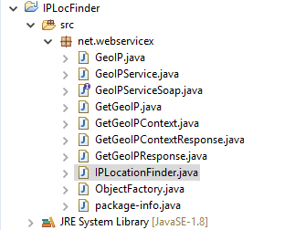
Directory structure

Slide 56
To find the ip address of website
Syntax:
ping<websiteurl>
Open command prompt
Type ping www.google.com
ping www.bbc.com

Slide 57
IPlocationFinder.java
package net.webservicex;
public class IPLocationFinder {
public static void main(String[] args) {
GeoIPService geoIPService = new GeoIPService();
GeoIPServiceSoap geoIPServiceSoap = geoIPService.getGeoIPServiceSoap();
//www.google.com - ip address 74.125.202.103
GeoIP geoIP = geoIPServiceSoap.getGeoIP("74.125.202.103");
System.out.println("Country Cdoe: " + geoIP.getCountryCode());
System.out.println("Country Name: " + geoIP.getCountryName());
}}

Slide 58
Output
Country Cdoe: USA
Country Name: United States

Slide 59
IPLocationFinder project

Slide 60
What are ways to test SOAP web services?
For testing SOAP : SOAPUI

Slide 61
SOAP UI
Soap ui is a tool, which is used to test SOAP and Restful web serivces.
We can download the soap from net and install it.
Steps to test soap Webservice:
Open soap ui
Create new project
Mention project name and wsdl url
Click on Next -> Next→… finish.
Automatically Request and response windows will be opened.
Enter the input in request and see the response.

Slide 62
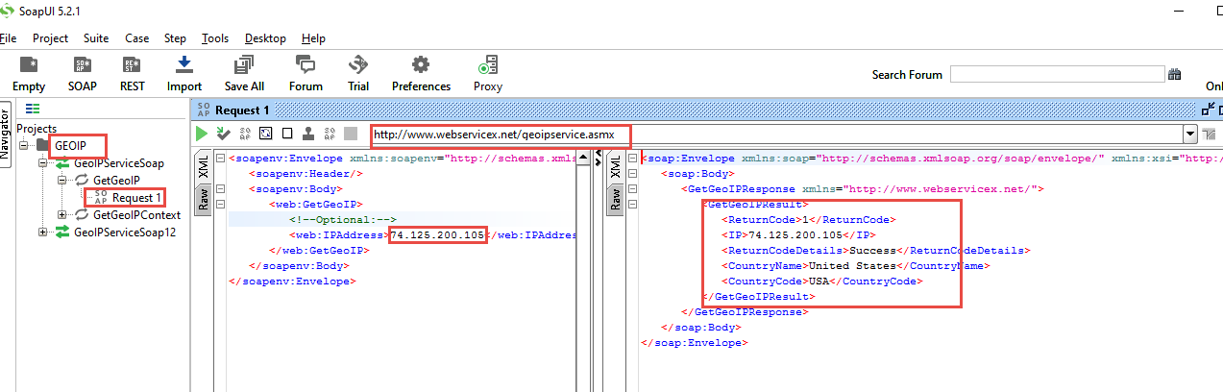
SOAP UI – output in XML format

Slide 63
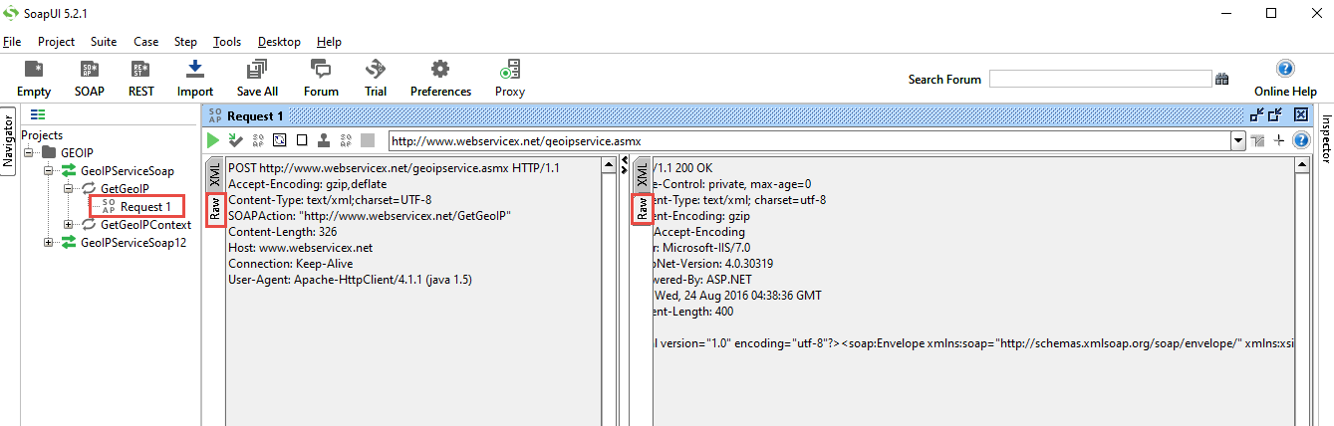
SOAP UI – output in raw format

Slide 64
SOAP web service example in java using eclipse
We will create hello world SOAP web service example in eclipse.
Eclipse provides good API for creating web services. Eclipse will do all work for you-creating WSDL,stub,endpoints etc. Steps for creating web services in eclipse:
1.Create new dynamic web project and name it "SimpleSOAPHelloWorldEx". 2.Create new package named “com.mangaraoit.webservices“
3.Create a simple java class named "HelloWorld.java" 4.Right click on project->new->web service -> Create Webservice for HelloWorld class
5. Deploy the application in Server and access it

Slide 65
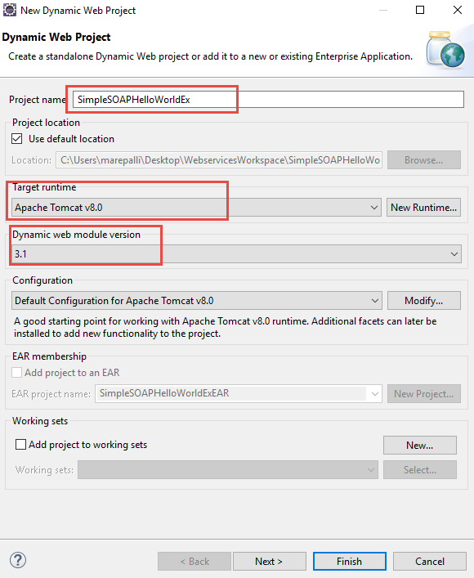
Create new dynamic web project and name it "SimpleSOAPHelloWorldEx".

Slide 66
HelloWorld.java
package com.mangaraoit.webserivces;
public class HelloWorld {
public String sayHelloWorld(String name){
return "Hello World by "+name;
}
}

Slide 67
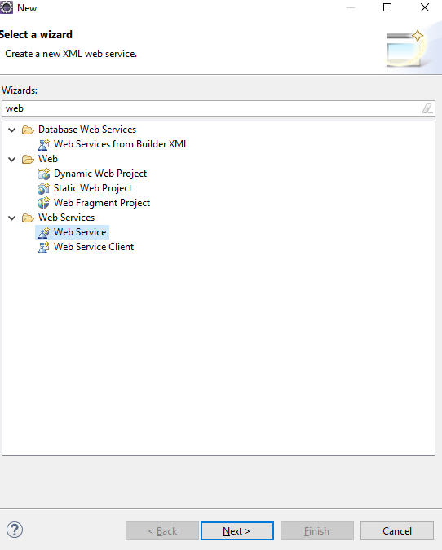
Right click on project->new->web service

Slide 68
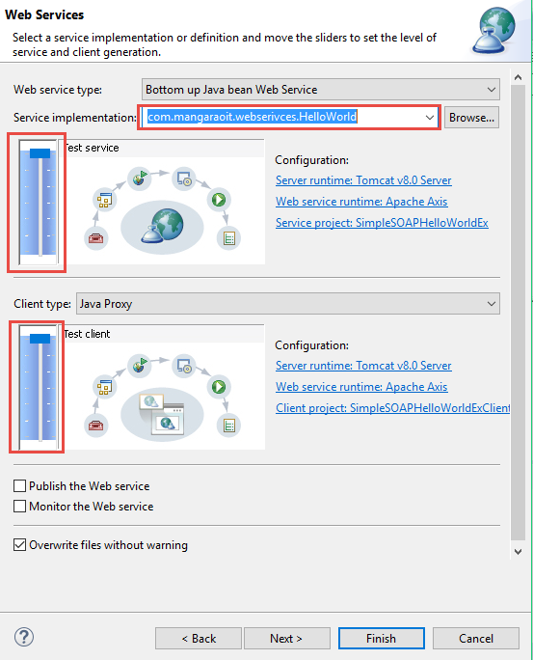
In service implementation text box, write fully qualified class name of below created class(HelloWorld.java) and move both below sliders to maximum level (i.e. Test service and Test Client level) and click on finish

Slide 69
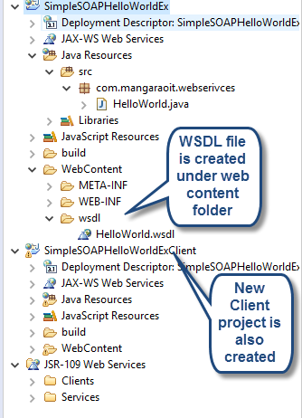
A new project named "SimpleSOAPHelloWorldEx" will be created in your work space.

Slide 70
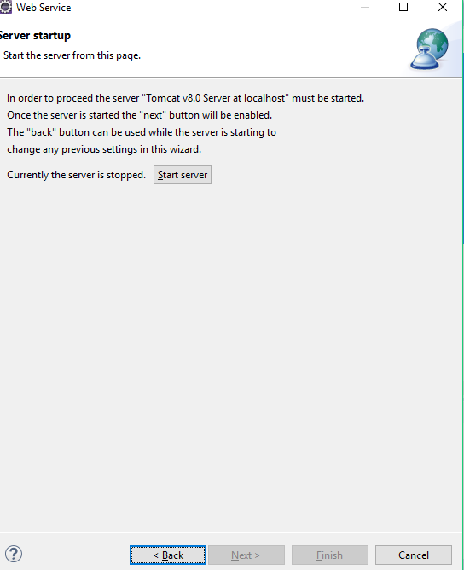
Click on start server

Slide 71
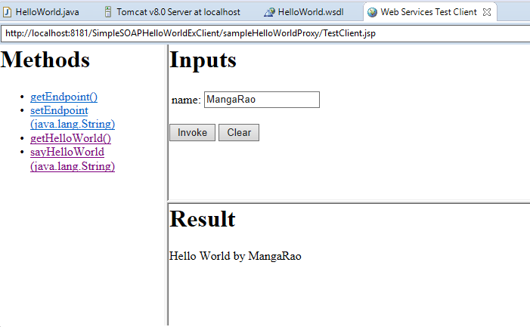
After clicking start server, eclipse will open test web service API. With this test API, We can test our web service.

Slide 72
Hurray !!! We are done!!.
To understand more about web services, We can explore above created " SimpleSOAPHelloWorldExClient " and learn more about web services.

Slide 73
Example: Develop JAX-WS endpoint and client step by step.
Prerequisites:
JDK 1.6
Eclipse IDE
Steps for creating JAX-WS webservice endpoint.
Open Eclipse
Create java project named "JAXWSServiceEx“
Create HelloWorld interface (EndPoint Interface)
Create HelloWorldImpl class
Create HelloWorldPublisher class
Run the HelloWorldPublisher class, Webservice will be published.

Slide 74
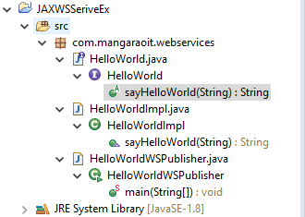
Directory Structure

Slide 75
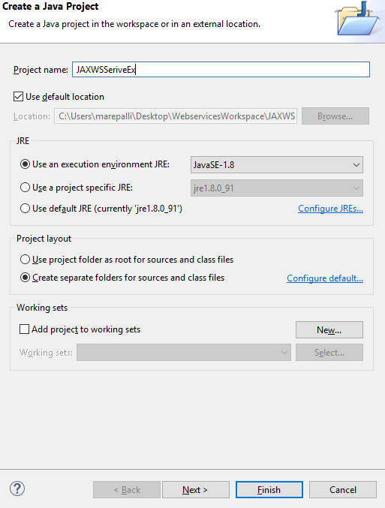
Create java project named "JAXWSServiceEx”

Slide 76
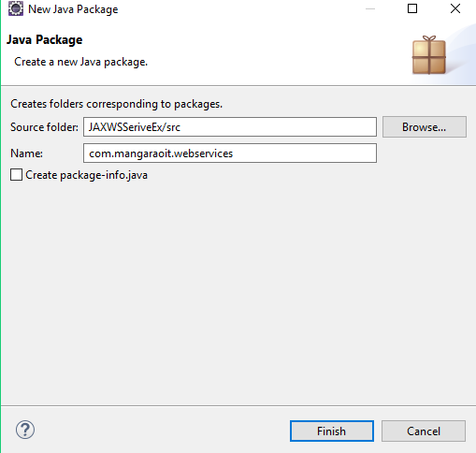
Create new package named “com.mangaraoit.webservices"

Slide 77
Create Endpoint Interface
package com.mangaraoit.webservices;
import javax.jws.WebMethod;
import javax.jws.WebService;
@WebService
public interface HelloWorld {
@WebMethod
public String sayHelloWorld(String name);
}

Slide 78
Create Endpoint Implementation
package com.mangaraoit.webservices;
import javax.jws.WebService;
@WebService(endpointInterface = "com.mangaraoit.webservices.HelloWorld")
public class HelloWorldImpl implements HelloWorld {
public String sayHelloWorld(String name) {
return "Hello World JAXWS Service by " + name;
}
}

Slide 79
Create Endpoint Publisher
package com.mangaraoit.webservices;
import javax.xml.ws.Endpoint;
public class HelloWorldWSPublisher {
public static void main(String[] args) {
Endpoint.publish("http://localhost:8182/WS/HelloWorld", new HelloWorldImpl());
System.out.println("Webserivce is published successfully ");
}
}
Note: Make sure the port number should not bind with other server.

Slide 80
Run above program. Your webservice is published. You can check your service wsdl at http://localhost:8182/WS/HelloWorld?wsdl
See below wsdl file output

Slide 81
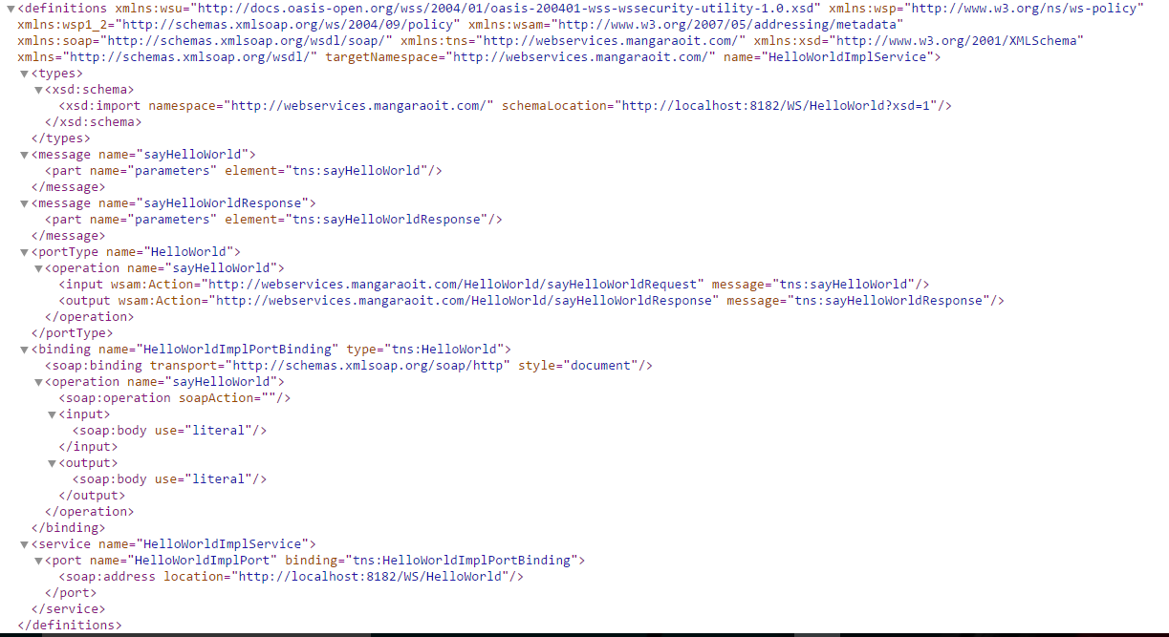

Slide 82
Steps for creating JAXWS Client
Open Eclipse
create a new java project JAXWSClient.

Slide 83
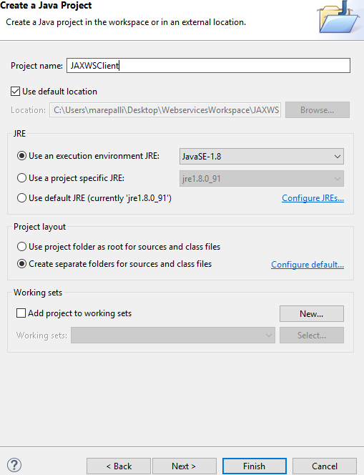
Create java project named “JAXWSClient”

Slide 84
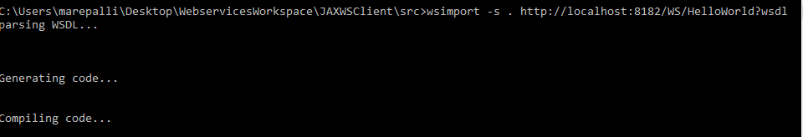
Now generate the client stubs. So open your command line, and enter the wsimport command:
cd %project_home%/src
wsimport -s . http://localhost:8182/WS/HelloWorld?wsdl
We will find java classes generated and compiled under src->com>mangaraoit ->webservices

Slide 85
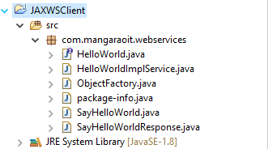
Refresh the project from eclipse

Slide 86
Create JAXWSClient.java under src->com.mangaraoit.webservices.client
package com.mangaraoit.webservices.client;
import com.mangaraoit.webservices.HelloWorld;
import com.mangaraoit.webservices.HelloWorldImplService;
public class TestHelloWorldWebService {
public static void main(String[] args) {
HelloWorldImplService helloWorldImplService = new HelloWorldImplService();
HelloWorld helloWorld = helloWorldImplService.getHelloWorldImplPort();
System.out.println(helloWorld.sayHelloWorld("AMR"));
}
}

Slide 87
Run the above program , following is the output
Hello World JAXWS Service by AMR

Slide 88
Congratulation, We have successfully created web service endpoint and client.
Now we can deploy web service end point to application server.
Here we will use tomcat as application server.
1) Open eclipse. 2) Create new dynamic web project named "HelloWorldJAXWS" 3) Create new package named "com.mangaraoit.webservice"

Slide 89
Steps to generate jaxws client using Eclipse
Open Eclipse
Create project (or) use existing project
File – New _ Web service Client
Select wsdl file location
Click on Next
Finish

Slide 90
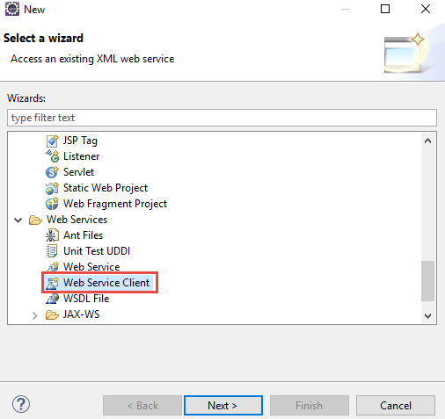
Right click on Project - Select Web Service Client

Slide 91
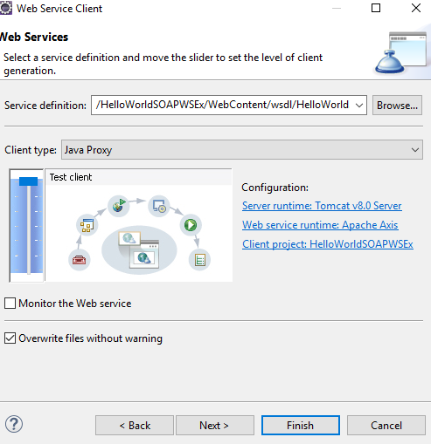
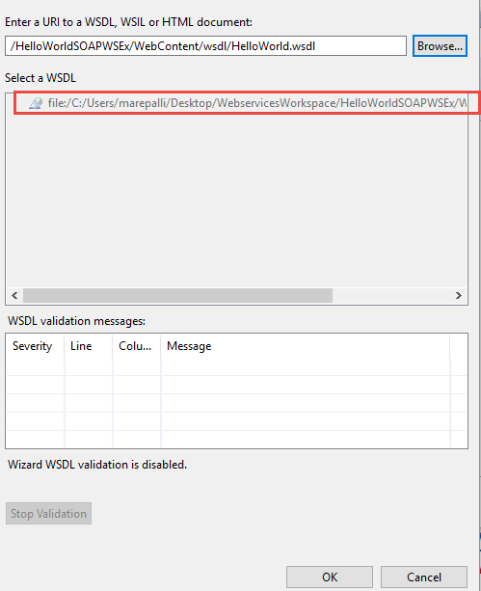
Click on Browse and select the wsdl file location, scroll up the Progress bar. Click on Next

Slide 92
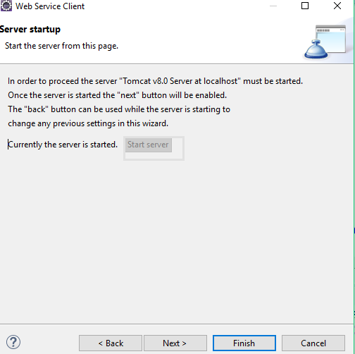
Start the server – to test Webservice, Finish

Slide 93
There are two ways to develop JAX-WS example.
RPC style
Document style

Slide 94
Difference between RPC and Document web services
RPC Style Document Style
1) The generated WSDL is difficult to be validated against schema.
2) In RPC style, SOAP message is sent as many elements.
3) RPC style message is tightly coupled.
4) In RPC style, SOAP message keeps the operation name.
5) In RPC style, parameters are sent as discrete values
6)RPC style web services use method name and parameters to generate XML structure.
1) Document style web services can be validated against predefined schema.
2) In document style, SOAP message is sent as a single document.
3) Document style message is loosely coupled.
4) In Document style, SOAP message loses the operation name.
5) In Document style, parameters are sent in XML format.

Slide 95
RPC style generated WSDL file.
In WSDL file, it doesn't specify the types details.
<types/>
For message part, it defines name and type attributes.
<message name="getHelloWorldAsString">
<part name="arg0" type="xsd:string"/>
</message>
<message name="getHelloWorldAsStringResponse">
<part name="return" type="xsd:string"/>
</message>
For soap:body, it defines use and namespace attributes.
<binding name="HelloWorldImplPortBinding" type="tns:HelloWorld">
<soap:binding transport="http://schemas.xmlsoap.org/soap/http" style="rpc"/>
<operation name="getHelloWorldAsString">
<soap:operation soapAction=""/>
<input>
<soap:body use="literal" namespace="http://mangaraoit.com/"/>
</input>
<output>
<soap:body use="literal" namespace="http://mangaraoit.com/"/>
</output>
</operation>
</binding>

Slide 96
Document style generated WSDL file.
In WSDL file, it doesn't specify the types details.
<types>
<xsd:schema>
<xsd:import namespace="http://mangaraoit.com/" schemaLocation="http://localhost:7779/ws/hello?xsd=1"/>
</xsd:schema>
</types>
For message part, it defines name and element attributes.
<message name="getHelloWorldAsString">
<part name="parameters" element="tns:getHelloWorldAsString"/>
</message>
<message name="getHelloWorldAsStringResponse">
<part name="parameters" element="tns:getHelloWorldAsStringResponse"/>
</message>

Slide 97
For soap:body, it defines use attribute only not namespace.
<binding name="HelloWorldImplPortBinding" type="tns:HelloWorld">
<soap:binding transport="http://schemas.xmlsoap.org/soap/http" style="document"/>
<operation name="getHelloWorldAsString">
<soap:operation soapAction=""/>
<input>
<soap:body use="literal"/>
</input>
<output>
<soap:body use="literal"/>
</output>
</operation>
</binding>

Slide 98
JAX-WS Example RPC Style
Creating JAX-WS example is a easy task because it requires no extra configuration settings.
JAX-WS API is inbuilt in JDK, so you don't need to load any extra jar file for it. Let's see a simple example of JAX-WS example in RPC style.
There are created 4 files for hello world JAX-WS example:
HelloWorld.java
HelloWorldImpl.java
Publisher.java
HelloWorldClient.java
The first 3 files are created for server side and 1 application for client side.

Slide 99
HelloWorld.java
package com.mangaraoit;
import javax.jws.WebMethod;
import javax.jws.WebService;
import javax.jws.soap.SOAPBinding;
import javax.jws.soap.SOAPBinding.Style;
//Service Endpoint Interface
@WebService
@SOAPBinding(style = Style.RPC)
public interface HelloWorld{
@WebMethod String getHelloWorldAsString(String name);
}

Slide 100
HelloWorldImpl.java
package com.mangaraoit;
import javax.jws.WebService;
//Service Implementation
@WebService(endpointInterface = "com.mangaraoit.HelloWorld")
public class HelloWorldImpl implements HelloWorld{
@Override
public String getHelloWorldAsString(String name) {
return "Hello World JAX-WS " + name;
}
}

Slide 101
Publisher.java
package com.mangaraoit;
import javax.xml.ws.Endpoint;
//Endpoint publisher
public class HelloWorldPublisher{
public static void main(String[] args) {
Endpoint.publish("http://localhost:7779/ws/hello", new HelloWorldImpl());
}
}

Slide 102
After running the publisher code, you can see the generated WSDL file by visiting the URL:
Let’s see JAX-WS Client Code

Slide 103
HelloWorldClient.java
package com.mangaraoit;
import java.net.URL;
import javax.xml.namespace.QName;
import javax.xml.ws.Service;
public class HelloWorldClient{
public static void main(String[] args) throws Exception {
URL url = new URL("http://localhost:7779/ws/hello?wsdl");
//1st argument service URI, refer to wsdl document above
//2nd argument is service name, refer to wsdl document above
QName qname = new QName("http://mangaraoit.com/", "HelloWorldImplService");
Service service = Service.create(url, qname);
HelloWorld hello = service.getPort(HelloWorld.class);
System.out.println(hello.getHelloWorldAsString("mangaraoit rpc"));
}
}

Slide 104
Output
Hello World JAX-WS mangaraoit rpc

Slide 105
JAX-WS Example Document Style
We can create JAX-WS example in document style. To do so, you need to change only one line in service interface.
You need to use Style.DOCUMENT for @SOAPBinding annotation in place of Style.RPC. Let's have a quick look at this:
@SOAPBinding(style = Style.DOCUMENT)//It is changed from RPC to DOCUMENT
1. HelloWorld.java 2. HelloWorldImpl.java 3. Publisher.java 4. HelloWorldClient.java
Use these four files of previous project, just change HelloWorld.java file style to Document
Note: By default style type is Document
If you run the publisher class, it may generate following error:
Wrapper class com.mangaraoit.GetHelloWorldAsString is not found.
Have you run APT to generate them?
To solve the problem, go to bin directory of your current project in command prompt and run the following command:
wsgen -keep -cp . com.mangaraoit.HelloWorldImpl
Now, it will generator 2 files:
SayHello
SayHelloResponse
Paste these files in com.mangaraoit directory and then run the publisher class.

Slide 106
JAX-RS
Java API for RESTful Web Services (JAX-RS), is a set if APIs to developer REST service. JAX-RS is part of the Java EE6, and make developers to develop REST web application easily.
JAX-RS uses annotations to define the REST relevance of Java classes.
There are implementation of JAX-RS API.
Jersey
RESTEasy
APACHE CXF
Spring with Rest

Slide 107
What is REST?
REST is an architectural style which is based on web-standards and the HTTP protocol.
REST was first described by Roy Fielding in 2000.
In a REST based architecture everything is a resource
A resource is accessed via a common interface based on the HTTP standard methods.
Every resource should support the HTTP common operations.
Resources are identified by global IDs (which are typically URIs). REST allows that resources have different representations, e.g., text, XML, JSON etc. The REST client can ask for a specific representation via the HTTP protocol (content negotiation).

Slide 108
HTTP METHODS
The PUT, GET, POST and DELETE methods are typical used in REST based architectures. The following table gives an explanation of these operations.
GET defines a reading access of the resource without side-effects. The resource is never changed via a GET request, e.g., the request has no side effects (idempotent).
PUT creates a new resource. It must also be idempotent.
DELETE removes the resources. The operations are idempotent. They can get repeated without leading to different results.
POST updates an existing resource or creates a new resource.

Slide 109
Jersey
Jersey is the implementation for this specification. Jersey contains basically a REST server and a REST client.
The core client can communicate with the server using jersey lib.
On the server side Jersey uses a servlet which scans predefined classes to identify RESTful resources. Via the web.xml configuration file for your web application.
The base URL of this servlet is:
http://your_domain:port/display-name/url-pattern/path_from_rest_class
This servlet analyzes the incoming HTTP request and selects the correct class and method depending on request. This selection is based on annotations provided in the class and methods.

Slide 110
JAX-RS Example Jersey
We can create JAX-RS example by jersey implementation. To do so, you need to load jersey jar files or use maven framework.
There are created 4 files for hello world JAX-RS example:
HelloWorld.java
web.xml
HelloWorldClient.java
The first 2 files are created for server side and 1 application for client side.

Slide 111
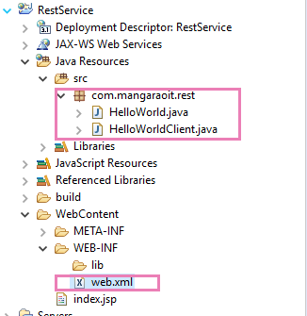
Directory Structure

Slide 112
Link to download jersey jar files
https://jersey.java.net/download.html
Now go to location where you have download jersey and go to jersey-archive-1.17->lib folder. you can have all jars but for now you can copy following jars asm-3.1
jersey-client-1.17
jersey-core-1.17
jersey-server-1.17
jersey-servlet-1.17
jsr311-api-1.1.1

Slide 113
Steps
Create a dynamic web project
Add jersey libraries to build path and lib folder of the project
Create Resource class
Mention jersey entries in web.xml
Deploy the project
Access the application

Slide 114
HelloWorld.java
package com.mangaraoit.rest; import javax.ws.rs.*;
@Path("/hello")
public class HelloWorld {
@GET
@Produces(MediaType.TEXT_PLAIN)
public Response sayPlainHello() {
return Response.status(200).entity("Hello Jersey Plain").build();
}
@GET
@Produces(MediaType.TEXT_XML)
public Response sayXMLHello() {
String output = "<?xml version=\"1.0\"?>" + "<hello> Hello Jersey" + "</hello>";
return Response.status(200).entity(output).build();
}
@GET
@Produces(MediaType.TEXT_HTML)
public Response sayHTMLHello() {
String output= "<html> " + "<title>" + "Hello Jersey" + "</title>" + "<body><h1>" + "Hello Jersey HTML" + "</h1></body>"
+ "</html> ";
return Response.status(200).entity(output).build();
}}

Slide 115
Note: ServletContainer package names are different for different jersey versions.
For Jersey 1.x -> ServletContainer package name starts with com. (com.sun.jersey.spi.container.servlet.ServletContainer)
For Jersey 2.x -> ServletContainer package name starts with org. (org.glassfish.jersey.servlet.ServletContainer)

Slide 116
web.xml
<servlet>
<servlet-name>jersey</servlet-name>
<servlet-class>com.sun.jersey.spi.container.servlet.ServletContainer</servlet-class>
<init-param>
<param-name>com.sun.jersey.config.property.packages</param-name>
<param-value>com.mangaraoit.rest</param-value>
</init-param>
<load-on-startup>1</load-on-startup>
</servlet>
<servlet-mapping>
<servlet-name>jersey</servlet-name>
<url-pattern>/rest/*</url-pattern>
</servlet-mapping>

Slide 117
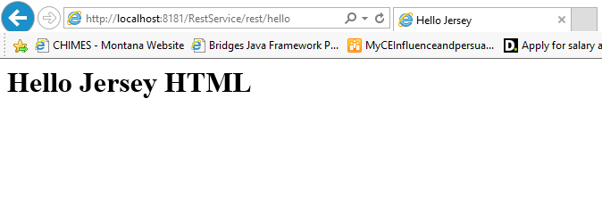
Now run this application on server. Access the application with following url

Slide 118
How to test Restful Webservice
POSTMAN (Chrome add on ): Add POSTMAN add on tool to the chrome
POSTMAN latest versions software is automatically downloaded and installed in to machine, works as a desktop application.
2. SOAP UI
3. Write Client code
4. JUNIT

Slide 119
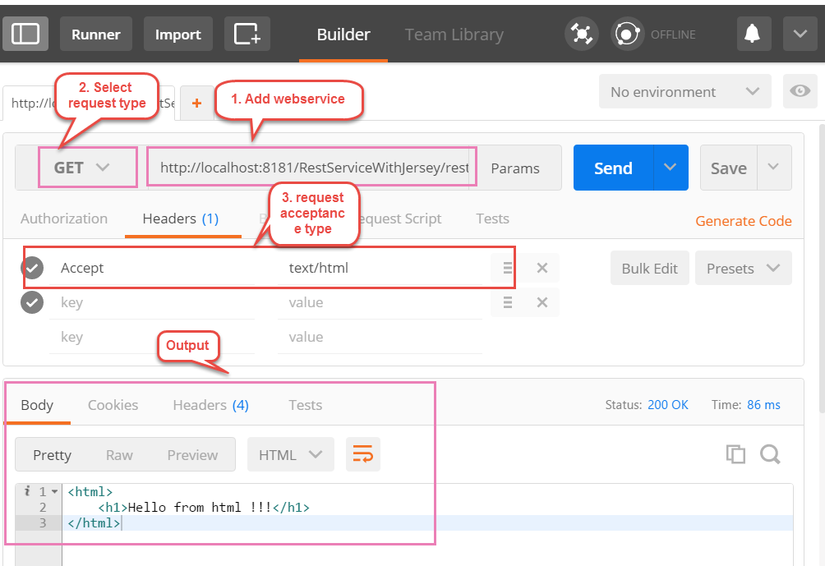
Use the POSTMAN tool

Slide 120
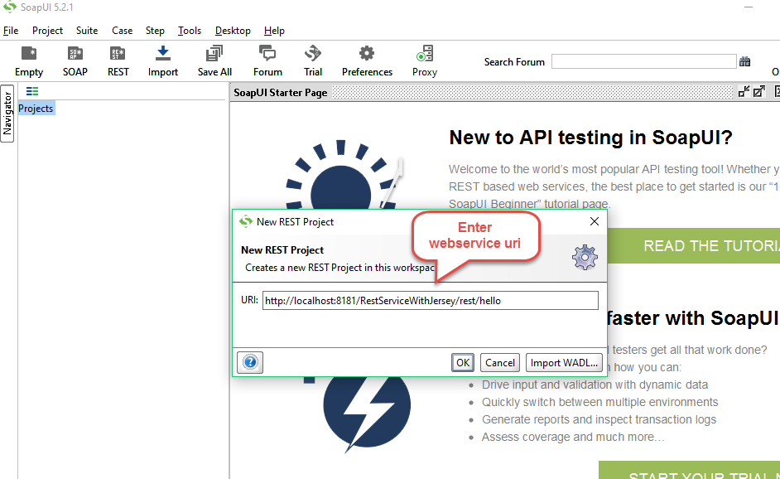
Test Restservice with SOAP UI Open the SOAP UI -> File -> New REST Project -> Enter web service uri (WADL file is also mentioned) -> Finish

Slide 121
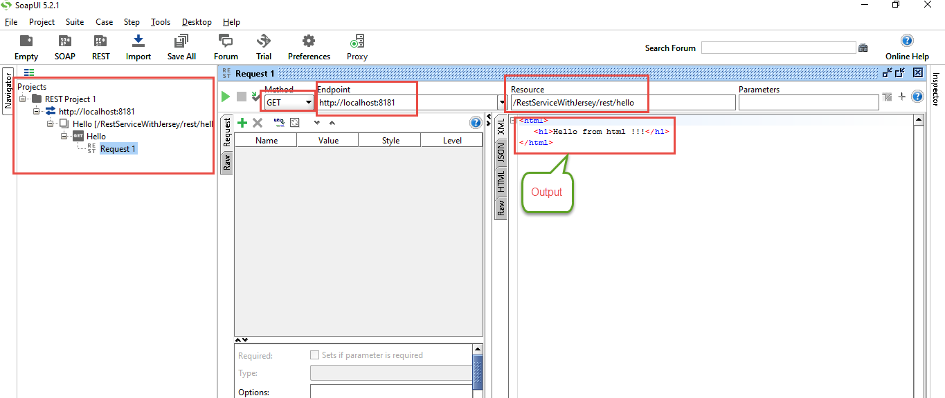
SOAP UI – Request and Response output view

Slide 122
JAX-RS Client Code
The ClientTest.java file is created inside the server application. But you can run client code by other application also by having service interface and jersey jar file.
package com.mangaraoit.rest;
public class HelloWorldClient {
public static void main(String[] args) {
Client client = Client.create();
WebResource resource = client.resource("http://localhost:8181/RestService/rest/hello");
ClientResponse clientResponse = resource.accept(MediaType.TEXT_PLAIN).get(ClientResponse.class);
//ClientResponse clientResponse = resource.accept(MediaType.TEXT_XML).get(ClientResponse.class);
//ClientResponse clientResponse = resource.accept(MediaType.TEXT_HTML).get(ClientResponse.class);
if(clientResponse.getStatus()==200){
String output = clientResponse.getEntity(String.class);
System.out.println(output);
}else{
System.out.println("something wrong");
} } }

Slide 123
Output:
Hello Jersey Plain
<?xml version="1.0"?><hello> Hello Jersey</hello>
<html> <title>Hello Jersey</title><body><h1>Hello Jersey HTML</h1></body></html>

Slide 124
RESTful JAX-RS Annotations
JAX-RS API provides following annotations to develop RESTful applications in java. We are using jersey implementation for developing JAX-RS examples.

Slide 125
Annotation | Description
Path | It identifies the URI path. It can be specified on class or method.
PathParam | represents the parameter of the URI path.
GET | specifies method responds to GET request.
POST | specifies method responds to POST request.
PUT | specifies method responds to PUT request.
HEAD | specifies method responds to HEAD request.
DELETE | specifies method responds to DELETE request.
OPTIONS | specifies method responds to OPTIONS request.
FormParam | represents the parameter of the form.
QueryParam | represents the parameter of the query string of an URL.
HeaderParam | represents the parameter of the header.
CookieParam | represents the parameter of the cookie.
Produces | defines media type for the response such as XML, PLAIN, JSON etc. It defines the media type that the methods of a resource class or MessageBodyWriter can produce.
Consumes | It defines the media type that the methods of a resource class or MessageBodyReader can produce

Slide 126
JAX-RS @Path, @GET and @PathParam Annotations
File: HelloService.java
package com.mangaraoit.rest;
@Path("/hello")
public class HelloService{
@GET
@Path("/{param}")
public Response getMsg(@PathParam("param") String msg) {
String output = "Jersey say : " + msg;
return Response.status(200).entity(output).build();
}
}

Slide 127
Just make jersey entries in web.xml
Access the url
localhost:portno/projectname/rest/hello/good day
Jersey say : good day

Slide 128
JAX-RS Multiple @PathParam Annotation
package com.mangaraoit.rest;
import javax.ws.rs.core.Response;
@Path("/hello")
public class HelloService{
@GET
@Path("{year}/{month}/{day}")
public Response getDate(
@PathParam("year") int year,
@PathParam("month") int month,
@PathParam("day") int day) {
String date = year + "/" + month + "/" + day;
return Response.status(200)
.entity("getDate is called, year/month/day : " + date)
.build();
}
}

Slide 129
Query Parameters : /rest/hello?name=am&age=27
It’s like query string But here separator is semi colon (;).
package com.mangaraoit.rest;
@Path("/hello")
public class HelloService{
@GET
public Response getMsg(@QueryParam(“name") String n
@QueryParam(“age") String a) {
String output = “user name " + n+ “age " + a;
return Response.status(200).entity(output).build();
}
}

Slide 130
Matrix Parameters : /rest/hello;name=amr;age=27
It’s like query string But here separator is semi colon (;).
package com.mangaraoit.rest;
@Path("/hello")
public class HelloService{
@GET
public Response getMsg(@MatrixParam(“name") String n
@MatrixParam(“age") String a) {
String output = “user name " + n+ “age " + a;
return Response.status(200).entity(output).build();
}
}

Slide 131
localhost:portno/appname/rest/hello/2014/12/05
Output:
getDate is called, year/month/day : 2014/12/5

Slide 132
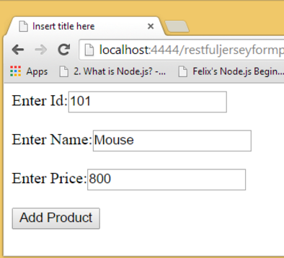
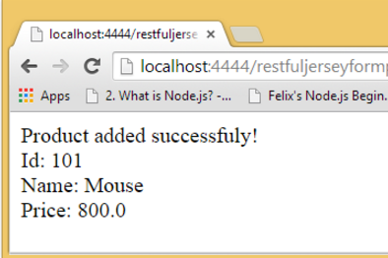
JAX-RS @FormParam and @POST Annotation

Slide 133
index.jsp
<form action="rest/product/add" method="post">
Enter Id:<input type="text" name="id"/><br/><br/>
Enter Name:<input type="text" name="name"/><br/><br/>
Enter Price:<input type="text" name="price"/><br/><br/>
<input type="submit" value="Add Product"/>
</form>

Slide 134
JAX-RS @FormParam and @POST Annotation
File: ProductService.java
package com.mangaraoit.rest;
import javax.ws.rs.core.Response;
@Path("/product")
public class ProductService{
@POST
@Path("/add")
public Response addUser(
@FormParam("id") int id,
@FormParam("name") String name,
@FormParam("price") float price) {
return Response.status(200)
.entity(" Product added successfuly!<br> Id: "+id+"<br> Name: " + name+"<br> Price: "+price)
.build();
}
}

Slide 135
Run the server and access the application.

Slide 136
Note: @Produces and @Consumes annotations
@Consumes annotation is used to specify request acceptance format types
@Consumes("application/xml)
@ Consumes("application/xml,application/json")
@Produces annotation is used to specify response format types
@Produces("application/xml)
@Produces("application/xml,application/json")
Both can be used on same method to specify request and response format types.

Slide 137
JAX RS Example – Produce output in json format from java object– Use jersey framework
Here to produce output in json format
1. jersey-json.jar file is required.
Internally Jersey converts java script object to JSON with Jackson help. Here Jackson is a JSON processor.
2. Add following entry in web.xml under Jersey Servlet Container
<init-param>
<param-name>com.sun.jersey.api.json.POJOMappingFeature</param-name>
<param-value>true</param-value>
</init-param>

Slide 138
Steps to create application. Let’s use maven for this example
Create Eclipse project
Convert in to Maven
Add following jersey dependencies in pom.xml
<dependency>
<groupId>com.sun.jersey</groupId>
<artifactId>jersey-server</artifactId>
<version>1.8</version>
</dependency>
<dependency>
<groupId>com.sun.jersey</groupId>
<artifactId>jersey-json</artifactId>
<version>1.8</version>
</dependency>
4. Right click on Project -> Update Project
5. Enter jersey entries in web.xml file
6. Create Product.java file with id, name, cost
7. Create Rest Service class
8.Access the application through uri

Slide 139
Web.xml
<servlet>
<servlet-name>jersey-servlet</servlet-name>
<servlet-class>com.sun.jersey.spi.container.servlet.ServletContainer</servlet-class>
<init-param>
<param-name>com.sun.jersey.config.property.packages</param-name>
<param-value>com.mangaraoit.rest</param-value>
</init-param>
<init-param>
<param-name>com.sun.jersey.api.json.POJOMappingFeature</param-name>
<param-value>true</param-value>
</init-param>
</servlet>
<servlet-mapping>
<servlet-name>jersey-servlet</servlet-name>
<url-pattern>/rest/*</url-pattern>
</servlet-mapping>

Slide 140
Product.java
package com.mangaraoit.bean;
public class Product {
private int id;
private String name;
private double price;
public Product(){
}
public Product(int id, String name, double price) {
this.id = id;
this.name = name;
this.price = price;
}
public int getId() {
return id;
}
public String getName() {
return name;
}
public double getPrice() {
return price;
}
//setter methods
}

Slide 141
ProductService
package com.mangaraoit.rest;
import com.mangaraoit.bean.Product;
@Path("/product")
public class ProductController {
@GET
@Produces(MediaType.APPLICATION_JSON)
public Response getProdDetails(){
Product product = new Product(101, "iphone6s", 70000);
returnResponse.status(200).entity(product).build();
}
}

Slide 142
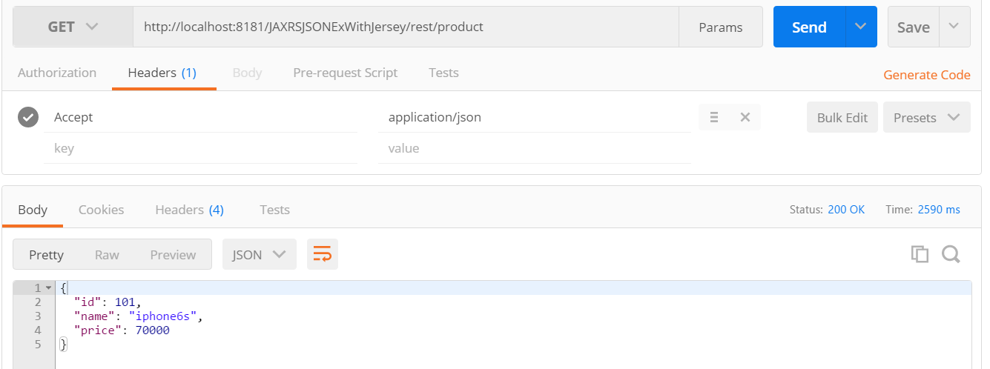
Output - Using POSTMAN

Slide 143
JAX RS Example – Produce output in XML format from Java object – Use jersey framework
Good News !! We are lucky !! Jersey internally contains JAXB libraries.
JAXB stands for Java XML Binding.
JAXB is used for Java to xml binding vice versa.
Steps to create the application:
1. Use the previous project , Just add annotations @XMLRootElement(name=“product”) on class , @XMLElement, @XMLAttribute on getter methods of Product class
2. Use previous project RESTClass, just change media type to @Produces(MediaType.APPLICATION_XML)
Note: Pojo class with xml annotations will work for both JSON and XML formats. In Json case, just xml annotations are ignored.
Note: Pojo class should have default (No – arg ) constructor. Then only It is converted to xml type.

Slide 144
Product.java
package com.mangaraoit.bean;
@XmlRootElement(name="myproducts")
public class Product {
private int id;
private String name;
private double price;
public Product(){
}
public Product(int id, String name, double price) {
super();
this.id = id;
this.name = name;
this.price = price;
}
@XmlAttribute
public int getId() {
return id;
}
@XmlElement
public String getName() {
return name;
}
@XmlElement
public double getPrice() {
return price;
}
//setter methods
}

Slide 145
ProductService
package com.mangaraoit.rest;
import com.mangaraoit.bean.Product;
@Path("/product")
public class ProductController {
@GET
@Produces(MediaType.APPLICATION_XML)
public Response getProdDetails(){
Product product = new Product(101, "iphone6s", 70000);
returnResponse.status(200).entity(product).build();
}
}

Slide 146
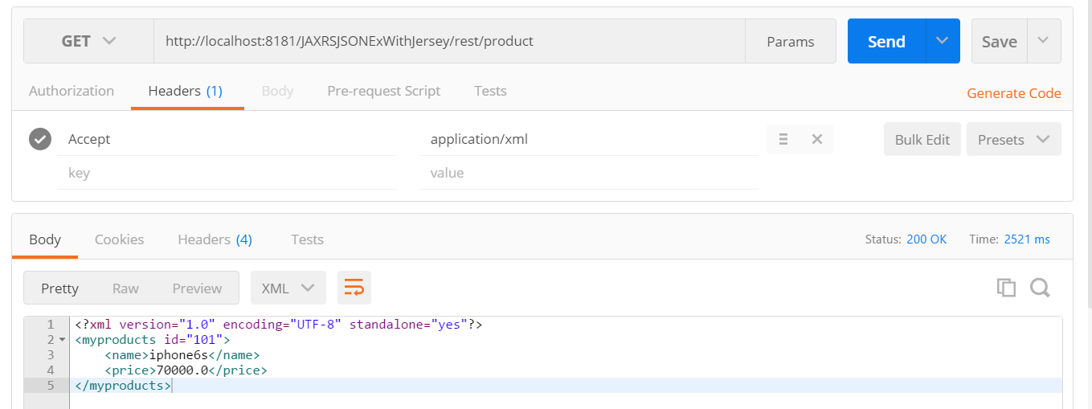
Output – Using POSTMAN

Slide 147
Multiple Resource Formats – See Example, One method which support both json and xml formats
Use the previous project, Just do following change on top of service method.
More than one format entries can be mentioned in @Produces annotation.
@Produces("application/xml,application/json")
Test the application for two formats.

Slide 148
Write a service method which accepts json and xml formats and returns same formats.
@Path("/product")
public class ProductController {
@GET
@Consumes("application/xml,application/json")
@Produces("application/xml, application/json" )
public Response getProdDetails(){
Product product = new Product(101, "iphone6s", 70000);
returnResponse.status(200).entity(product).build();
}
}

Slide 149
Write a service method which accepts only json and returns xml format
@Path("/product")
public class ProductController {
@GET
@Consumes("application/json")
@Produces("application/xml" )
public Response getProdDetails(){
Product product = new Product(101, "iphone6s", 70000);
returnResponse.status(200).entity(product).build();
}
}

Slide 150
No. | SOAP | REST
1) | SOAP is a protocol. | REST is an architectural style.
2) | SOAP stands for Simple Object Access Protocol. | REST stands for REpresentational State Transfer.
3) | SOAP can't use REST because it is a protocol. | REST can use SOAP web services because it is a concept and can use any protocol like HTTP, SOAP.
4) | SOAP uses services interfaces to expose the business logic. | REST uses URI to expose business logic.
5) | JAX-WS is the java API for SOAP web services. | JAX-RS is the java API for RESTful web services.
6) | SOAP defines standards to be strictly followed. | REST does not define too much standards like SOAP.
7) | SOAP requires more bandwidth and resource than REST. | REST requires less bandwidth and resource than SOAP.
8) | SOAP defines its own security. | RESTful web services inherits security measures from the underlying transport.
9) | SOAP permits XML data format only. | REST permits different data format such as Plain text, HTML, XML, JSON etc.
10) | SOAP is less preferred than REST. | REST more preferred than SOAP.

Slide 151
Spring Restful web services
We have knowledge on Spring MVC and RESTful Webservices.
Let’s work with combinations of both to develop Webservices.
After spring 3, Spring supported Restful Webservices.

Slide 152
Steps to create simple spring rest application which returns plain text
1. Create a dynamic web project named SpringRestHelloWorldEx
2. Convert it to Maven project
3. Add spring dependency entries in to pom.xml
4. Add Dispatcher servlet entry in web.xml
5. Create a xml file names springrest-servlet.xml under WEB-INF folder
6. Create a controller class

Slide 153
Add spring dependency files in pom.xml , Make sure spring version is 4.X
<properties>
<spring.version>4.3.0.RELEASE</spring.version>
</properties>
<dependencies>
<dependency>
<groupId>org.springframework</groupId>
<artifactId>spring-core</artifactId>
<version>${spring.version}</version>
</dependency>
<dependency>
<groupId>org.springframework</groupId>
<artifactId>spring-webmvc</artifactId>
<version>${spring.version}</version>
</dependency>
</dependencies>

Slide 154
Add Spring front controller entry in web.xml
<servlet>
<servlet-name>springrest</servlet-name>
<servlet-class>org.springframework.web.servlet.DispatcherServlet</servlet-class>
<load-on-startup>1</load-on-startup>
</servlet>
<servlet-mapping>
<servlet-name>springrest</servlet-name>
<url-pattern>/*</url-pattern>
</servlet-mapping>

Slide 155
springrest-servlet.xml change context:component-scan to spring search for controller classes
<?xml version="1.0" encoding="UTF-8"?>
<beans xmlns="http://www.springframework.org/schema/beans"
xmlns:xsi="http://www.w3.org/2001/XMLSchema-instance"
xmlns:context="http://www.springframework.org/schema/context"
xmlns:mvc="http://www.springframework.org/schema/mvc"
xsi:schemaLocation="http://www.springframework.org/schema/beans
http://www.springframework.org/schema/beans/spring-beans.xsd
http://www.springframework.org/schema/context
http://www.springframework.org/schema/context/spring-context.xsd
http://www.springframework.org/schema/mvc
http://www.springframework.org/schema/mvc/spring-mvc.xsd">
<context:component-scan base-package="com.mangaraoit.controllers"/>
<mvc:annotation-driven/>
</beans>

Slide 156
Create Controller HelloWorldController.java
package com.mangaraoit.controllers;
import org.springframework.web.bind.annotation.PathVariable;
import org.springframework.web.bind.annotation.RequestMapping;
import org.springframework.web.bind.annotation.RequestMethod;
import org.springframework.web.bind.annotation.RestController;
@RestController
@RequestMapping("/hello")
public class HelloWorldController {
@RequestMapping(value="/{name}", method=RequestMethod.GET)
public String hello(@PathVariable String name){
return "Hello "+name;
}
}

Slide 157
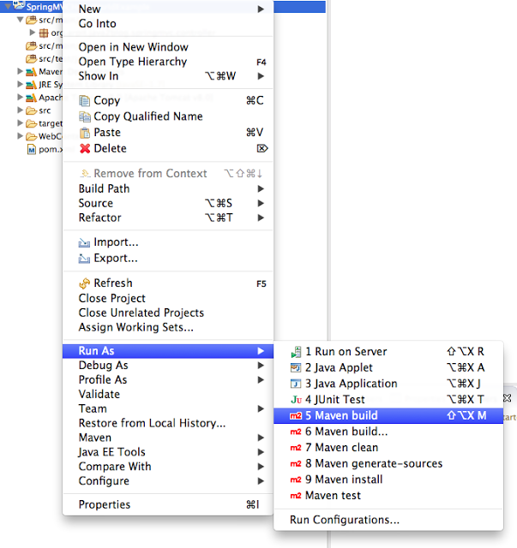
do maven build. Right click on project -> Run as -> Maven build

Slide 158
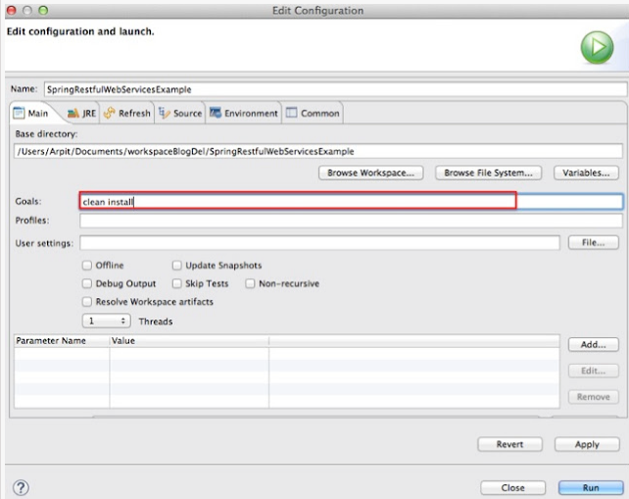
Provide goals as clean install (given below) and click on run

Slide 159
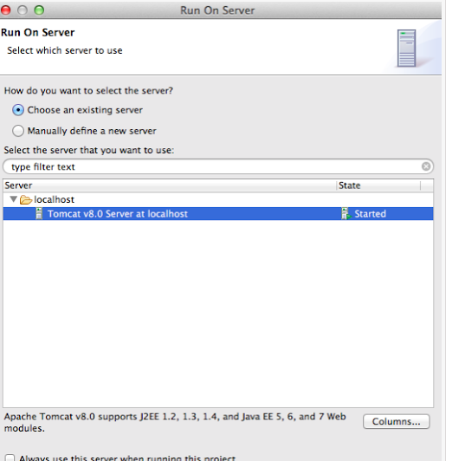
Run the application -Right click on project -> run as -> run on server Select apache tomcat and click on finish

Slide 160
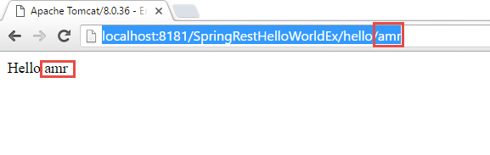
Test your REST service under: http://localhost:8181/SpringRestHelloWorldEx/hello/amr

Slide 161
Notes
We are not providing any view information in springrest-servlet.xml as we do in Spring MVC.
If we need to directly get resource from controller, we need to return @ResponseBody as per Spring 3 but with Spring 4, we can use @RestController for that.
In spring 4.0, we can use @RestController which is combination of @Controller + @ResponseBody. @RestController = @Controller + @ResponseBody.

Slide 162
Spring Restful web services json Example
Steps are same as previous project.
Just We are going to change pom.xml and create Country bean class and CountryController class.
1. pom.xml
2. Country.java (Bean)
3. CountryController.java (Controller)
We need to add Jackson json utility in the classpath. So add below entry in pom.xml <dependency>
<groupId>com.fasterxml.jackson.core</groupId>
<artifactId>jackson-databind</artifactId>
<version>2.7.5</version>
</dependency>
Spring will load Jackson2JsonMessageConverter into its application context automatically. Whenever you request resource as json with accept headers="Accept=application/json", then Jackson2JsonMessageConverter comes into picture and convert resource to json format.

Slide 163
pom.xml
<properties>
<spring.version>4.3.0.RELEASE</spring.version>
</properties>
<dependencies>
<dependency>
<groupId>org.springframework</groupId>
<artifactId>spring-core</artifactId>
<version>${spring.version}</version>
</dependency>
<dependency>
<groupId>org.springframework</groupId>
<artifactId>spring-webmvc</artifactId>
<version>${spring.version}</version>
</dependency>
<dependency>
<groupId>com.fasterxml.jackson.core</groupId>
<artifactId>jackson-databind</artifactId>
<version>2.7.5</version>
</dependency>
</dependencies>

Slide 164
Country.java
package com.mangaraoit.beans;
public class Country {
private int id;
private String name;
public Country(){
System.out.println("No arg constructor is invoked");
}
public Country(int id, String name) {
this.id = id;
this.name = name;
}
//setter getter methods
}

Slide 165
CountryController.java
package com.mangaraoit.controllers;
@RestController
public class CountryController {
private List<Country> countriesList(){
List<Country> countriesList = new ArrayList<>();
countriesList.add(new Country(1, "India"));
countriesList.add(new Country(2, "USA"));
countriesList.add(new Country(3, "Germany"));
return countriesList;
}

Slide 166
@RequestMapping(value="/country", method=RequestMethod.GET, headers="Accept=application/json")
public List<Country> getCounties(){
return countriesList();
}
@RequestMapping(value="/country/{id}", method=RequestMethod.GET, headers="Accept=application/json")
public Country getCountryById(@PathVariable int id){
List<Country> countriesList = countriesList();
for (Country country : countriesList) {
if(id==country.getId()){
return country;
}}
return null;
}
}

Slide 167
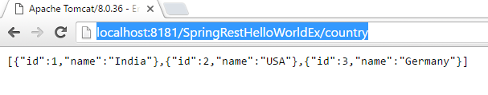
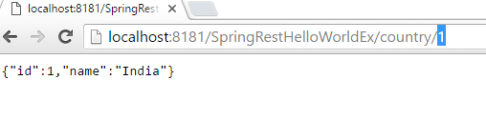
Test the service
http://localhost:8181/SpringRestHelloWorldEx/country
Now pass country id as parameter to url.
http://localhost:8181/SpringRestHelloWorldEx/country/1

Slide 168
Spring Restful web services xml example
For XML support, we just need to make sure JAXB jar is available in classpath.
Automatically JAXB jars available with spring So no need to add jaxb jars explicitly.
It’s same as previous project, change is only in
Country.java – In Country class add @XMLRootElement, @XMLElement annotations
CountryController.java - In controller class just chamge headers value to application/xml (headers="Accept=application/xml)
Below are changes for two service methods.
@RequestMapping(value = "/countries", method = RequestMethod.GET,headers="Accept=application/xml")
@RequestMapping(value = "/country/{id}", method =RequestMethod.GET,headers="Accept=application/xml)

Slide 169
Country.java
package com.mangaraoit.beans;
@XmlRootElement(name="country")
public class Country {
private int id;
private String name;
public Country(){
System.out.println("No arg constructor is invoked");
}
public Country(int id, String name) {
this.id = id;
this.name = name;
}
@XmlElement
public int getId() {
return id;
}
@XmlElement
public String getName() {
return name;
}
//setters
}

Slide 170
CountryController.java
package com.mangaraoit.controllers;
@RestController
public class CountryController {
private List<Country> countriesList(){
List<Country> countriesList = new ArrayList<>();
countriesList.add(new Country(1, "India"));
countriesList.add(new Country(2, "USA"));
countriesList.add(new Country(3, "Germany"));
return countriesList;
}

Slide 171
@RequestMapping(value="/country", method=RequestMethod.GET,
headers="Accept=application/xml")
public List<Country> getCounties(){
return countriesList();
}
@RequestMapping(value="/country/{id}", method=RequestMethod.GET, headers="Accept=application/xml")
public Country getCountryById(@PathVariable int id){
List<Country> countriesList = countriesList();
for (Country country : countriesList) {
if(id==country.getId()){
return country;
}}
return null;
}
}

Slide 172
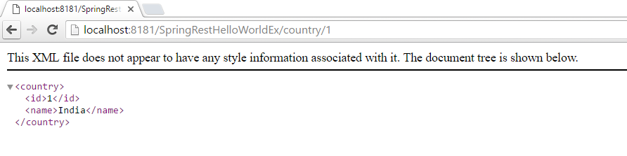
Test the service
http://localhost:8181/SpringRestHelloWorldEx/country
http://localhost:8181/SpringRestHelloWorldEx/country/1

